Slide 1
Region Conference
UFARS Hot Topics
Deb Meier and Molly Koppes| Education Finance Specialists
April 2024

Slide 2

Ten Minnesota Commitments to Equity
Prioritize equity.
Start from within.
Measure what matters.
Go local.
Follow the money.
Start early.
Monitor implementation of standards.
Value people.
Improve conditions for learning.
Give students options.

Slide 3
Agenda
FY 24 UFARS Updates
FY 24 Lease Levy and LTFM Updates
UFARS Coding Guidance
Food and Nutrition Guidance
UFARS Data Submissions
Other Information
SOD
UFARS COVID-19 Coding Guidance
GASB Statements No. 87 and 96 (for reference)

Slide 4
FY 24 UFARS Updates

Slide 5
FY 23 MN State Legislation
Unemployment Compensation – Hourly Workers Over the Summer Term
New for FY 23 – legislation is effective as of May 28, 2023
Object Code 281 Unemployment Compensation – Hourly Workers Over the Summer Term
Include expenditures incurred for unemployment compensation for hourly workers over the summer term. Please use Fund 01, Finance Code 000 with all expenditures related to this object code.
*For FY 23 and FY 24 must use Finance Code 000, since the expenditures will be reimbursed through the additional funds created by legislation.

Slide 6
FY 2024 Program Code
Updated the following program code, because it is no longer allowed with Basic Skills beginning in FY 24.
217 Assurance of Mastery
Record expenditures for activities conducted under the Assurance of Mastery Program (Minn. Stat. 124D.66 [2022]).
Notes:
Changes are in bold

Slide 7
FY 2024 Program Code
Updated the following program code:
579 Preschool – Instructional (Fund 04)
Record all costs for non-fee based preschool programs that provide educational opportunities to children 3 through 5 years old that do not generate average daily membership with respect to MARSS. Childcare costs should be reported in Program Code 570 for children kindergarten through sixth grade. Use Program Code 590 for child care programs for children less than five years old.
Notes:
Changes are in bold

Slide 8
FY 24 UFARS Finance Codes
Deleted the following Finance Codes for FY 24:
151-153, 165-166, 168, 171, 173 – Federal COVID funds
518 ARRA Targeted Funds – Head Start Funds

Slide 9
FY 24 UFARS Finance Codes
Deleted the following Finance Codes for FY 24:
309 Basic Skills for Extended Time
An unintended consequence of the MN legislation language changes in Compensatory revenue uses was the elimination of funding for extended school day or school year expenses. (#11 in the 2022 statutes now removed in the 2023 version). In 2017, there was statute language passed that required LEA’s to set aside a percentage of their compensatory funding to use for extended day/year activities; this was directly correlated to the authority in #11 in statute and our UFARS grid. In the 2020 legislative session, this statute language was repealed, but there were districts that had fund balances from the funds required to be set aside from FY18-FY20.
Up until now some districts have plugged away at the their balances (in Fund Balance 459) using the authority in compensatory under #11 and others were holding the balance. The 2023 legislation eliminated #11, tied to Finance code 309 that allowed districts to spend down the excess funds not yet spent.
MDE is working with legislation for a resolution to the above issue for those LEAs that still have a fund balance in 459.

Slide 10
FY 24 UFARS Finance Codes
Finance Code 317 Basic Skills was updated to reflect the May 2023 legislative changes to the allowable uses (UFARS Chapter 10 has also been updated):
Remedial instruction and necessary materials in reading, language arts, mathematics, other content areas or study skills to improve the achievement level of these learners;
Additional teachers and teacher aides to provide more individualized instruction to these learners through individual tutoring, lower instructor-to-learner ratios, or team teaching;
a longer school day or week during the regular school year or through a summer program that may be offered directly by the site or under a performance-based contract with a community-based organization;
Notes:
Item #3 can be used for the “old” Finance Code 309 expenditures.
NOTE: Program Code 217 AOM is no longer an eligible expenditure for Finance Code 317.

Slide 11
FY 24 UFARS Finance Codes
4. Programs to reduce truancy; provide counseling services; guidance services, and social work services; and provide coordination for pupils receiving services from other governmental agencies;
5. Bilingual programs, bicultural programs, and programs for English learners – see also Finance Code 339 English Learner;
6. Early education program, parent-training programs, early childhood special education, school readiness programs, kindergarten programs for four-year olds, voluntary home visits under section 124D.13, subdivision 4, and other outreach efforts designed to prepare children for kindergarten;
7. Transition programs operated by school districts for special education students until the age of 22;

Slide 12
FY 24 UFARS Finance Codes
8. Substantial parent involvement in developing and implementing remedial education or intervention plans for a learner, including learning contracts between the school, the learner, and the parent that establish achievement goals and responsibilities of the learner and the learner's parent or guardian. (Excluding parent involvement activities associated with early learning programs under paragraph 6 above.)
9. Professional development for teachers on meeting the needs of English learners, using assessment tools and data to monitor student progress, and reducing the use of exclusionary discipline, and training for tutors and staff in extended day programs to enhance staff’s knowledge in content areas.
Notes:
Fin 317 – item #9 will allow Prog 640

Slide 13
FY 24 UFARS Finance Codes
Updated Finance Codes for FY 24:
Finance Code 303 Area Learning Center - The program folks at MDE added information to the description to state the following: Revenue generated by a particular program, as determined by school number in either the 41 or 45 school classification, can only be spent on that program which generated the revenue. For example, revenue generated by school number 040 in school classification 41 can only be spent on school number 040 in school classification 41.
  An example for Fin 303 is if revenue is generated at Targeted Services, the money must be spent on Targeted Services.

Slide 14
FY 24 UFARS Finance Codes
Updated Finance Codes for FY 24:
Finance Code 324 update title to: GED Testing and Adult Basic Education (ABE) Supplemental Services
Finance Code 438/638: Federal ABE Revenue – updated the law reference
Finance Code 801/901 updated title: Adult Basic Education (ABE) Integrated English Literacy and Civics Education (IELCE) Competitive Allocation
Notes:
Changes are in bold

Slide 15
FY 24 UFARS Finance Codes
NEW Finance Codes due to May 2023 MN legislation:
312 Literacy Incentive Aid
314 Paraprofessional Training
339 English Learner
343 School Library Aid
373 Student Support Personnel
374 Student Support Personnel – Cooperative or Intermediate
Area Learning Center (ALC) Transportation Aid
742 Special Education Separate Sites and Programs
Notes:
*The chapter 10 grids were updated and reposted to the MDE UFARS webpage in February.
For Finance Code 314, we added Object Code 270 workers compensation as an allowable code in Chapter 10, however, the reimbursement calculation will NOT include this object code based on current guidance.

Slide 16
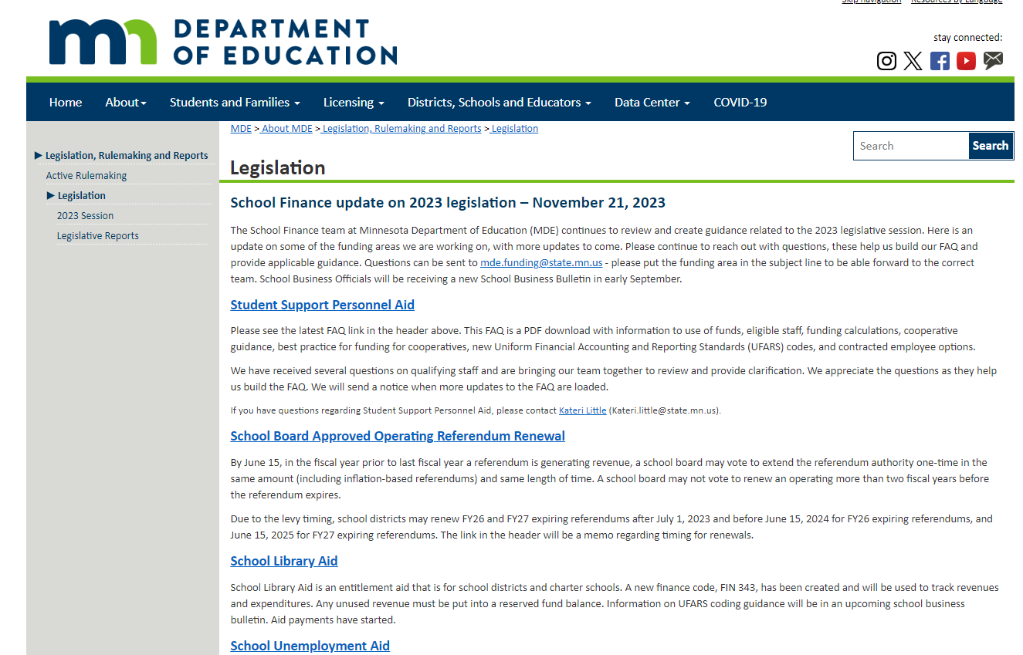
FY 24 UFARS Finance Codes
There are May 2023 legislative updates on this webpage:

Slide 17
FY 24 UFARS Finance Code 312
Finance Code 312 Literacy Incentive Aid
Effective July 1, 2023, Minnesota Statutes 2022, section 124D.98 Literacy Incentive Aid, was amended by adding a subdivision to read:
Subd. 5 Literacy incentive aid uses.
A school district must use its literacy incentive aid to support implementation of evidence-based reading instruction. The following are eligible uses of literacy incentive aid:
  training for kindergarten through grade 3 teachers, early childhood educators, special education teachers, reading intervention teachers working with students in kindergarten through grade 12, curriculum directors, and instructional support staff that provide reading instruction, on using evidence-based screening and progress monitoring tools;
  evidence-based training using a training program approved by the Department of Education;
  employing or contracting with a literacy lead, as defined in section 120B.1118;
  materials, training, and ongoing coaching to ensure reading interventions under section 125A.56, subdivision 1, are evidence-based; and
  costs of substitute teachers to allow teachers to complete required training during the teachers’ contract day.
Therefore, we have added UFARS Finance Code 312 Literacy Incentive Aid and updated UFARS Chapter 10 to appropriately code the expenditures beginning July 1, 2023. Also, the fund balance must be reserved in 412 Restricted/Reserved for Literacy Incentive Aid.
Notes:
Previously, Literacy Incentive Aid DID NOT have a list of uses, so any general education expenditures were allowable.

Slide 18
FY 24 UFARS Finance Code 339
Finance Code 339 English Learner
The FY 25 expenditures in this finance code will be used to calculate the 25% subsidy for FY 27. However, we have asked LEAs to use this code for the amount overspent for FY 24.
We are waiting for more information from legislation for how this will work with Finance Code 317 Basic Skills allowable uses.
Notes:
This is a 25% subsidy if there are additional expenditures

Slide 19
FY 24 UFARS Finance Code 343
Finance Code 343 School Library Aid
School districts and charter schools are eligible to received School Library Aid. There is no application process as this is an automatic distribution of state aid.
Aid is the greater of $16.11 per Adjusted Pupil Unit (APU) for the current year, or $40,000 for school districts and $20,000 for charter schools.
Unspent School Library Aid must be reserved in Balance Sheet account 443 Restricted/Reserved for School Library Aid.
School Library Aid must be reserved and used for directly funding the costs of the following purposes within a library:
  Salaries and benefits of a school library media specialist
  Electronic, computer and audiovisual equipment
  Information technology infrastructure and digital tools
  Electronic and material resources
  Furniture, equipment, or supplies

Slide 20
FY 24 UFARS Finance Code 343
Finance Code 343 School Library Aid
School districts and charter schools can use the aid to pay for existing school library media specialists currently paid through other funding.
For the purposes of spending School Library Aid, a district or charter must identify space within their sites or buildings that is accessible to all enrolled students for use of equipment and checkout of materials. This space could be a part of an educational classroom or other common space, but there must be times set aside that the area deemed ‘library’ can be accessed by all students. Districts and charters may also purchase online library resources, but those resources must be accessible to all students, and devices should be available in the designated library space if programming or software is purchased.

Slide 21
FY 24 UFARS Finance Code 343
Finance Code 343 School Library Aid
There is an FAQ posted on MDE’s webpage.
For questions contact:
Kateri Little at Kateri.little@state.mn.us

Slide 22
FY 24 UFARS Finance Codes 373 & 374
Finance Code 373 Student Support Personnel Aid and Finance Code 374 Student Support Personnel Aid Cooperative or Intermediate
There is an FAQ posted on MDE’s webpage.
For questions contact:
Kateri Little at Kateri.little@state.mn.us
For revenues, use source code 300: State Aids Received from MDE for which a Finance Code Is Specified”. The code string will look like this:
01-XXX-XXX-373-300-000
01-XXX-XXX-374-300-000
Notes:
The FAQ outlines the UFARS accounting for Finance Code 373 and 374.

Slide 23
FY 24 UFARS Object Codes
Delete Object Code 380 Short-Term Leases for Computer or Technology Related Hardware (Object Codes 465 /466 Non-Instructional/Instructional Technology Devices already existed and this code was a duplicate.)
Updated the following Object Code:
896 Taxes, Special Assessments, and Interest Penalties
Use this code to record all expenditures incurred by the district for any local, state, federal tax or interest penalty (i.e. arbitrage). This would include all property tax and special assessment expenditures. This would also include “Patient-Centered Outcomes Research Institute” (PCORI) fees associated with the Affordable Care Act (ACA). Use Balance Sheet Code 212 to pay the sales tax collected on the sale of materials.
Note: For LTFM projects, Object Code 896 can only be used for arbitrage.

Slide 24
FY 24 UFARS Object Codes
Updated the following Object Code:
899 Miscellaneous Expenditures
Expenditures made for items not otherwise classified. Do not use this object code for chargeback expenditures.
The miscellaneous code expenditures have been increasing in alarming amounts the past few years. When we report to the federal government, we have to explain the increases. We have to contact LEAs with large amounts in order to provide an explanation.
Please review the UFARS turnaround edit report for Object Code 899 warnings.
Please contact us if you need assistance with expenditures coding in this area.
Notes:
Ken Moos, formerly of Financial Management and retired now, used to bring and a box with the Object Code 899 information and would ask explanations from districts when at the MASBO conference.

Slide 25
FY 24 UFARS Course Codes
Course code changes:
Professional Development (Current Year Federal Award)
Professional Development (Prior Year Federal Award)
642 Professional Development (Second Prior Year Federal Award)
Notes:
These course codes are no longer needed for Title programs. They are still required for some programs, such as special education.

Slide 26
FY 24 UFARS Course Codes
Course code deletions related to Title programs:
634/627/621 Highly Qualified
639/632/626 School Choice and Supplemental Education Services
667/668/669 School Improvement

Slide 27
FY 24 UFARS Balance Sheet Codes
New Balance Sheet Codes due to Minnesota legislation in May 2023:
Restricted/Reserved for Literacy Incentive Aid
Restricted/Reserved for English Learner
443 Restricted/Reserved for School Library Aid

Slide 28
FY 24 UFARS Balance Sheet Codes
Updated Balance Sheet Code 431 Restricted/Reserved for Community Ed to remove ABE from the description.
Updated Balance Sheet Code 447 Restricted/Reserved for ABE to enhance the description.

Slide 29
School Business Bulletins
School Business Bulletin #72 was published in July 2023 and outlines new legislation passed during the 2023 session.
A follow up Bulletin #73 was published in September with additional information.
Both Bulletins can be found on the Financial Management Webpage by selecting “Districts, School and Educators”, “Business and Finance”, “School Finance”, “Financial Management”.

Slide 30

FY 24 UFARS Chapter 10 Updates

Slide 31
FY 24 Chapter 10 Updates
All finance codes to remove Object Code 380
Finance Code 302 Operating Capital for May 2023 legislative additional uses
Finance Codes 313 Achievement and Integration and Finance Code 318 Incentive Revenue remove Object Codes 378 and 899 from Funds 01 & 18
Finance Code 317 Basic Skills for May 2023 legislative updated uses
Finance Code 342 Safe Schools Revenue for May 2023 legislative additional uses
Finance Code 372 Medical Assistance with Program Code 400 – ADD Object Code 392
LTFM reminder that Program Code 865 will not be allowed with Fund 06 for FY 24 and future years.

Slide 32
FY 24 Chapter 10 Updates
Finance Codes 322 - State Adult Basic Education (ABE) and 324 - Adult Basic Education Supplemental Services
Remove Object Codes: 161-162, 171-172, 361, 380, 535, 561, 571 & 581
Finance Codes 438/638 - Federal Adult Basic Education Formula Revenue, 801/901 – ABE IELCE Competitive Allocation and 803/903 – ABE Statewide Supplemental Services – Regular Federal Competitive
Remove Object Codes: 161-162, 171-172, 361, 380, 535, 561, 571, 581 and 589.

Slide 33

Lease Levy and LTFM Updates for FY 24

Slide 34
FY 24 UFARS Finance Code 348 and Lease Levy
Minnesota Department of Education (MDE) will be delaying the implementation of using Finance Code 348 Charter School Building Lease Aid and School District Lease Levy Authority as a validation tool for school district’s lease levy in FY 24. Currently, an LEA ,may code leases to Finance Code 348.
Please focus on the type of lease the district has and use the correct object codes for the specific leases. Districts can continue to use Finance Code 000 and Finance Code 302 Operating Capital to record the building leases and/or leases submitted through the lease levy system.
Notes:
FY 25 – MDE is reviewing the finance code for school district lease levy.

Slide 35
FY 24 UFARS Finance Code 348 and Lease Levy
MDE Division of School Finance staff will be reviewing the following object codes for validation and staff will reach out if there are specific questions.
Object Code 570 Principal on Long-Term Building and/or Land Leases
Object Code 571 Interest on Long-Term Building and/or Land Lease
Object Code 580 Principal on Long-Term Lease or Financed Purchases
Object Code 581 Interest on Long-Term Lease or Financed Purchases
MDE Division of School Finance will continue to review our validation systems for lease levy.
Notes:
FY 23 Changes

Slide 36
FY 24 UFARS Finance Code 348 and Lease Levy
348 Charter School Building Lease Aid and School District Lease Levy Authority (Fund 01)
Charter Schools should record revenue and expenditures for Charter School Building Lease Aid. When a charter school finds it economically advantageous to rent or lease a building or land for any instructional purpose and it determines that the total operating capital revenue per Minnesota Statutes 2021, section 126C.10, subdivision 13, is insufficient for this purpose, it may apply to the commissioner for Building Lease Aid per Minnesota Statutes 2021, section 124E.22.
School district types 01, 02 or 03 can record revenue and expenditures for lease levy authority in this code for expenditures to lease a building or parcel of land for instructional purposes only. Instructional purposes means that it relates to the current academic curriculum. Curriculum may include but is not limited to sports fields/venues utilized during physical education, additional classroom space for increased student population, facilities that meet academic curriculum requirements not found in their current facilities (i.e. computer or science and technology labs). School district building lease aid should not be used for facilities or land that is outside of the current academic curriculum. Facilities that fall under this classification are lighted sports fields or facilities used solely outside of normal operating hours, graduation venues, student and/or employee parking, etc. should be coded to any other appropriate finance codes.
This finance code must be used only with Program Code 850.
Payment Description – 01F348 BLDGLEASE AID FY
Notes:
FY 23 Changes

Slide 37
FY 24 UFARS Finance Code 348 Accounting Treatment
Updated Accounting treatment for when a school district levies for a building lease on behalf of another LEA.
The district should code the revenue to 01-005-850-348-001-000 or 01-005-850-302-001-000 or 01-005-850-000-001-000.
The Cooperative, intermediate or education district should invoice the District for the portion owed the cooperative, intermediate or education district.
The District should code the cooperative, intermediate or education district invoice to the same finance code as the revenue was reported in step one above: 01-005-850-348-570/571-000 or 01-005-850-302-570/571-000 or 01-005-850-000-570/571-000.
The cooperative, intermediate or education district should code the revenue to Finance Code 000 with Source Code 021. If the cooperative, intermediate or education districts have expenditures for the building lease, they should use Finance Code 000 with the appropriate object codes.
Notes:
For charter schools, they must have approval for their building lease expenditures and use Finance Code 348 for revenues and expenditures. Charter schools are organization type 07.
Finance Code 348 is only available to school districts that can levy for building expenditures. Finance Code 348 expenditures for school districts will be reviewed and approved in the summer levy. Therefore, if a school district has approval for the school district lease levy authority, the school district must use Finance Code 348 for revenues and expenditures. Only the following school district organization types are allowed: Type 01 – Independent Districts and Schools, Type 02 – Common Districts and Schools and Type 03 – Special Districts and Schools.
Finance Code 302 Operating Capital allows any school that has revenue for Operating Capital to use Operating Capital to rent or lease buildings in item no. 3. This type of expenditure would not be included in the summer levy.

Slide 38
LTFM Updates
The following paragraph has been added in the FY 23 UFARS Program Code chapter above Program Code 865:
Long-Term Facilities Maintenance (LTFM) Program Codes 865, 866, 867 and 868
Note: Finance Codes 347, 349, 352, 355, 358, 363, 366-370 and 379-384 are used for LTFM expenditures and revenues. All projects funded by the LTFM aid and levy must be restricted/reserved in Balance Sheet Code 467 and expensed in the General Fund (01). See Source Code 317 Long-Term Facilities Maintenance and State Aid and Source Code 001 Property Tax Levy – General Fund 01 for revenue recording. A revenue transfer, equal to the total expenditures, is required for all expenditure activity in the Construction Fund (06).

Slide 39
LTFM Updates
Program Code 865 Long-Term Facilities Maintenance (LTFM) Projects per Site, Per Year – Excluding Costs in Program Codes 866, 867 and 868 (Fund 01 and 06)
Record costs for LTFM projects not included in Program Codes 866, 867 or 868, which includes projects less than $100,000 in all LTFM Finance Codes and includes Health and Safety and Deferred Maintenance projects costing less than $2,000,000 per site, per year. See the note above Program Code 865 for the LTFM Finance Code list and accounting treatment instructions.
See Program Code 866 for pay-as-you-go projects costing $100,000 to $1,999,999 per site, per year for Finance Codes 358 – Asbestos, 363 – Fire Safety and 366 – Indoor Air Quality. See Program Code 867 for projects that are bond financed. See Program Code 868 for all projects costing $2,000,000 or more per site, per year that are financed on a pay-as-you-go basis, but not included in Program Code 866. For more information regarding Long-Term Facilities Maintenance please see Minnesota Statutes 2021, section 123B.595.
Note: This change is effective for FY 24, but the rest of the LTFM changes were effective FY 23.
Notes:
FY 24 for Program 865 only. Programs 866-868 will have updates applied for FY 23.

Slide 40
LTFM Updates
Program Code 866 Long-Term Facilities Maintenance (LTFM) Projects per Site, per Year – $100,000-$1,999,999.99 for Finance Codes 358, 363 and 366 (Fund 01 and 06)
Record costs for LTFM pay-as-you go projects for ONLY Finance Codes 358, 363 and 366 (Asbestos, Fire Safety and Indoor Air Quality) that are $100,000 or more per site, per year up to $1,999,999.99. Use Program Code 867 for all LTFM projects that are bond financed. Use Program Code 868 for LTFM Projects that are $2,000,000 or more and financed by pay-as-you-go for all other LTFM finance codes.
Notes:
FY 23 Changes

Slide 41
LTFM Updates
Program Code 867 Long-Term Facilities Maintenance (LTFM) Projects per Site, per Year that are Bond Financed (Fund 06)
This Program Code can only be used with Fund 06, Building Construction Fund, for projects that are bond financed. Use Program Code 868 for LTFM projects that are $2,000,000 or more per site, per year and financed on a pay-as-you-go basis.
Notes:
FY 23 changes

Slide 42
LTFM Updates
868 Long-Term Facilities Maintenance (LTFM) Projects per Site, per Year that are $2,000,000 or More and Financed on a Pay-As-You-Go Basis (Fund 06)
This Program Code can only be used with Fund 06, Building Construction Fund, for projects that are $2,000,000 or more per site and financed on a pay-as-you-go basis. Use Program Code 867 for LTFM projects that are bond financed.
Notes:
FY 23 Changes

Slide 43
UFARS Coding Guidance

Slide 44
State Grants
State Grants that do not have a specific finance code should be coded to Finance Code 000.
LEAs may choose to use crosswalks for the expenditures.
Please use Source Code 369 Other Revenue from Other State Agencies or Source Code 370 Other Revenue from Minnesota Dept. of Education for the revenue.

Slide 45
Nonpublic Expenditures
To calculate nonpublic revenues accurately, the districts need to code the expenditures in the following manner:
to the appropriate MDE ORG site code; and
the appropriate program code, i.e. 203 Education – Elementary General versus 211 Education – Secondary General.

Slide 46
Fund 20 Internal Service Expenditures
Due to the warnings for Object Code 899 on the UFARS Turnaround Reports, we discovered there was an issue with self insurance object codes.
For Fund 20 Internal Service Fund insurance claims use Object Code 220 Health Insurance or Object Code 235 Dental Insurance.
We have reviewed and updated Object Codes 220 and 235 to include claims paid.

Slide 47
ECSE Expenditures
For ECSE expenditures, Paul Ferrin recommends the following for paying the slot fee for school readiness programs. When an LEA’s IEP places students into these programs, the LEA is able to report the educational time in MARSS under grade level EC to generate ADM/Gen Ed revenue.
LEAs should use Finance Code 000, since this is a Gen Ed cost. The LEAs can use Program Code 400 General Special Education or 412 Developmentally Delayed Education since the Finance Code is 000 and the cost is not eligible for Special Education reimbursement. As for the object code LEAs can use Object Code 305, 390 or 393.

Slide 48
Early Learning Scholarship Funds
Finance Code 337 Early Learning Scholarships Program- Pathway II and/or Finance Code 338 Early Learning Scholarships Program- Pathway I are reimbursement grants. Please ensure that there are expenditures before requesting revenue.
There should not be a fund balance for either of these finance codes, as the revenues should be less than or equal to the expenditures.
For Early Learning questions, please contact MDE.ELS@state.mn.us
For UFARS questions, please contact mde.ufars-accounting@state.mn.us
Notes:
Mention we are aware it has been transfers from Balance Sheet Codes in the past.

Slide 49
UFARS Early Childhood Screening
The Education Bill that was signed on May 24, 2023 by Governor Walz and included increased funding for Early Childhood Screening. If there is a shortfall in funding, please code the transfer from General Fund as follows:
  01-005-950-XXX-910-000 $10,000
  04-005-583-354-649-000 $10,000
For questions please contact: Margaret Chresand (margaret.chresand@state.mn.us)
Notes:
Mention we are aware it has been transfers from Balance Sheet Codes in the past.

Slide 50
Title Funds
The Distinct Purposes of ESEA Funds
Federal ESEA Title awards come with the requirement that funds be spent on allowable costs. An allowable cost must “be necessary and reasonable for the performance of the Federal award.” [2 CFR 200.403]
To help understand what is “necessary,” a new Distinct Purposes of ESEA Title Funds document has been posted on the MDE ESEA/Federal Programs webpage with short summaries of the purpose of each ESEA Title program managed by the MDE Student Access and Opportunity Division. More information about each fund, its purpose, and what is allowable can be found on the MDE ESEA/Federal Programs or by contacting the program specialist.

Slide 51
Title Funds – SERVS and MEGS
Timeline for ESEA Title Program Applications SY24
The SFY24 timeline for actions in MEGS and SERVS Financial related to ESEA Title program funds under finance codes 401, 406, 414, 417, and 433 is now available on MDE ESEA Grant Application Tools webpage.
Local educational agencies (LEAs) are encouraged to compete the actions prior to the due dates listed. Unless otherwise noted, extensions can be requested by emailing mde.esea@state.mn.us prior to the given due date. Extensions are not needed for “priority dates.”
Contact mde.esea@state.mn.us with questions.
Notes:
We emailed the information above to those on the Business Managers list serv on 4/20/23.
ALSO, we recently learned that there will be comparison reports in MEGS, but we are not aware of the details.
SERVS/UFARS comparison reports will not work if the LEA made a change to the original budget. Also UFARS Course Code 013 expenditures does not show up on the UFARS/SERVS comparison report either.

Slide 52
Food and Nutrition Guidance

Slide 53
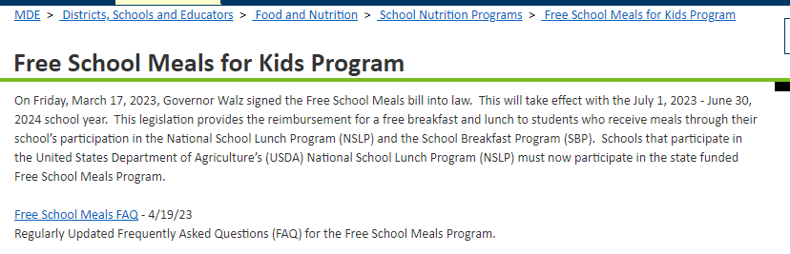
Food Service Additional State Funding
In summary, there will not be additional UFARS codes, since UFARS codes already exist for state funded breakfast and lunch.
For questions regarding food and nutrition, please email: mde.fns@state.mn.us
Notes:
Simply an increase in current funding buckets.

Slide 54
Minnesota Free School Meals Program
What happens to existing school meal debt with the passing of the Free School Meals bill?
The passing of this bill does not affect the financial management of money owed to the school nutrition program. The household is still responsible for money owed to the school nutrition program until the unpaid meal charges are considered uncollectable by the district. When that determination is made, the amount then becomes classified as bad debt. 2 CFR § 200.426 Bad debts
For more information and accounting treatment for handling delinquent or uncollectable debt, please see the May 2019 School Business Bulletin #64.
The process is the same for nonpublic schools using the entity’s own financial structure.

Slide 55
Minnesota Free School Meals Program (2)
Do we need to refund the money on meal accounts?
If your school/school district will sell a la carte items or second meals next school year, funds can remain on students’ prepaid accounts to pay for these a la carte items.
Refunds should be made if an a la carte program will not be available for students to purchase and/or if a parent requests a refund of funds on the account.
If the owner of the funds cannot be located, the funds cannot accrue to the district and must be reported as unclaimed property to MN Department of Commerce – Unclaimed Property Division

Slide 56
Farm to School Grants
The Farm to School Grants are being administered by MDE food service.
The AGRI Equipment Grant is funded by State funds (for equipment). Use revenue code 02-XXX-770-701-369-000 and code expenditures to 02-XXX-770-701-5XX-000.
The Farm to School First Bite Grant is federal revenue (for food). The revenue code is 02-XXX-770-699-405-000.
For the federal expenditures please use codes 02-XXX-770-699-XXX-000.
For questions regarding these grants, please email: mde.fns@state.mn.us

Slide 57
Supply Chain Assistance Funds (Fund 02)
Supply Chain Assistance Funds - ALN# 10.555 (formerly known as CFDA#)
Disbursed over multiple years
Revenue
  R02-XXX-770-710-471-000 Required
  Use Course Code 000 for all fiscal years of the Finance Code 710
Expense
  E02-XXX-770-710-490-000 Food
  E02-XXX-770-710-495-000 Milk
Unspent funds considered Unearned Revenue at year-end (reversing entry) – update as of 10/25/23- the unspent funds are considered part of the Restricted Fund Balance
Considered fully expended when Total Revenue FIN710 = Total Expense FIN710 (No Deadline)
1st Allocation | 4/11/2022 | Payment of Supply Chain Assistance Funds
2nd Allocation | 11/04/2022 | Payment of 2nd Allocation Supply Chain Assistance Funds
3rd Allocation 4th Allocation | 2/24/2023 Oct-Nov 2023 | Payment of 3rd Allocation Supply Chain Assistance Funds Payment of 4th Allocation Supply Chain Assistance Funds
NEW

Slide 58
Temporary Flexibility for Net Cash Resource Limitation
The United States Department of Agriculture (USDA) has provided guidance that State Agencies (SAs) have the discretion to approve a net cash resource more than three months average expenditures per 7 CFR 210.14(b) and 210.19(a)(1)
USDA understands that many external factors are leading SFAs to have additional funds and therefore an approval of more than three months may be necessary.
MDE assesses compliance with the net cash resource limitation in January for the previous school year. For SY2022, the limitation will be reviewed on a case by case basis.
Effective SY 22-23, Minnesota Department of Education (MDE) is increasing the net cash resource limitation to six months average operating expenditures. **Remains in effect for SY 23-24**
The allowed limitation will be reviewed annually and an eventual return to standard regulation will take place.

Slide 59
Fund 02 Unallowable Costs
Advance Payment to Contractors - Meal Service Contracts
Food Service Management Company (FSMC)
Vended Meal Provider
Issue:
School is providing funds to private for-profit business prior to receiving service
Perception:
School is loaning private for-profit business an interest free loan using restricted funds
Fact:
Violates Minnesota Public Purpose Doctrine (derived from Minnesota State Constitution, Art. X § 1)

Slide 60

UFARS Data Submissions

Slide 61
FY 2023 UFARS Data Submission Deadlines
FY 2024 Preliminary Unaudited UFARS (September 15, 2024)
FY 2024 Final Audited UFARS (November 30, 2024)
FY 2024 Fiscal Compliance Table (November 30, 2024)
FY 2024 Audit Report (December 31, 2024)
Please note if the deadline falls on a weekend or legal holiday, submissions are timely if they are submitted on the next succeeding day which is not a Saturday, Sunday or legal holiday (Minn. Stat. §474A.025).

Slide 62
FY 2023 UFARS Data Submission Deadlines
School Finance Award is based upon the following – related to the UFARS Turnaround Reports:
  MDE receiving the unaudited UFARS submission by September 15.
  MDE receiving the audited UFARS submission by November 30 – the final submission must have NO ERRORS.
  There are many other determining factors for the School Finance Award, the criteria is listed at the beginning of the award recipients for FY 2023 (based on 2022 reporting), go to:
  https://education.mn.gov/MDE/dse/schfin/fin/guide/
  *The FY 2024 Finance Award (based on 2023 reporting) will be issued later this spring.

Slide 63
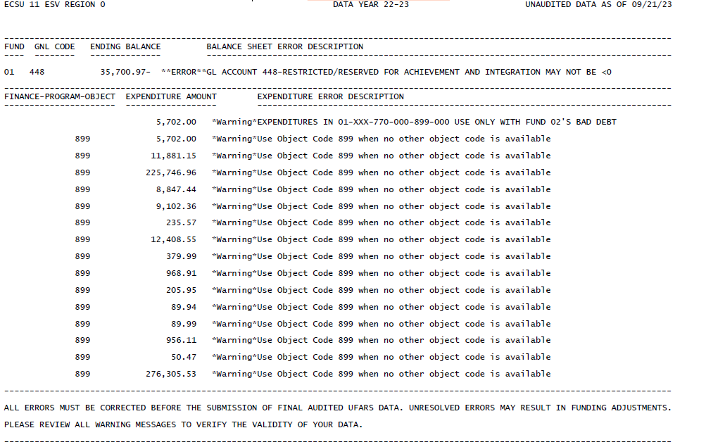
FY 23 UFARS Turnaround Reports

Slide 64
FY 23 UFARS Turnaround Reports
We contacted many school districts and charter schools to determine large amounts in Object Code 899 due to the new warning.
  Food Service bad debt should still be expended in 01-XXX-770-000-899-000. We are removing this warning for FY 24.
  ECSE slot fees – see slide #48 – use Object Codes 305, 390 or 393.
  MDE has met to determine appropriate object codes for the following:
  1. Self-insured medical and dental insurance claims should be coded to Object Code 220 or 235.
  2. Student activity closures or transfers to another student activity and donations to valid 501(c)(3) organizations. Use Object Code 899 and Source Code 099.
  3. Hotels or motel expenditures for homeless families should use Object Code 335 beginning in FY 25.
  4. Ticket sales expenditures for MSHSL events. Use the appropriate Object codes for staff salaries (Object Code 185 or 186) with Object codes 2xx. Use other appropriate Object Code 3xx for non-staff and code the revenue to gate receipts.
  5. Ticket sales revenue and reimbursement for MSHSL events should be coded to Fund 18 with Source Code 099 Misc. Revenue from Local Sources.
Notes:
We are working with MNIT to streamline the UFARS turnaround edit report.

Slide 65
Other Information

Slide 66
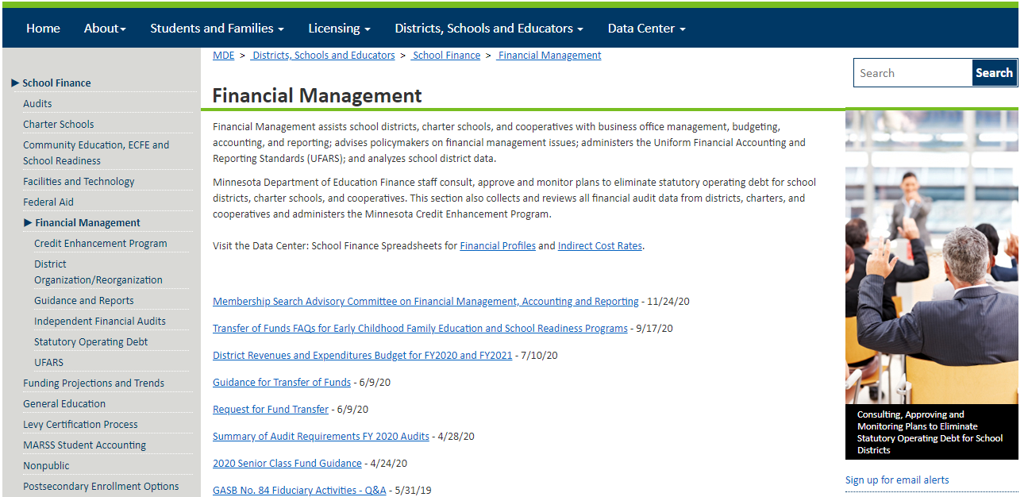
Sign up for MDE email alerts
Notes:
Sign up for email alerts in the financial management area. You need to sign up in each area for specific alerts.

Slide 67
MDE Calendar
About MDE > Calendar
Future UFARS 101 Trainings
UFARS 101 training will introduce Uniform Financial Accounting and Reporting Standards (UFARS) and review: A) Chart of Accounts; B) UFARS System Uses; C) Code Descriptions; D) Legislative Requirements, and review basic accounting concepts and financial reporting for Minnesota schools. The training will also include expenditures/revenues exercises and website navigation.
Registration information for future UFARS 101 workshops are posted on the MDE calendar webpage or by following About MDE > Calendar.
MDE Financial Management Staff is currently planning virtual training options.
Notes:
Next session July 27th.

Slide 68
Business Manager Listserv
Business Managers Listserv Subscriptions
This service is provided to business managers by MDE as an ongoing communication informing them of current MDE news. If you are a new subscriber or updating current information, please contact Nicki Cha (nicki.cha@state.mn.us) and provide the following information in your email:
First Name
Last Name
District Name
District Number
Email
Phone Number
Phone Extension
Staff Position

Slide 69
Statutory Operating Debt (SOD) and Fiscal Responsibility

Slide 70
SOD
Most of the COVID-19 additional funds are expiring at the end of FY 24 (June 30, 2024).
As your schools work on the FY 25 budgets, it is important that the decrease in funding be recognized during the budget planning for FY 25 and future years.
School districts and charters schools are required to comply with Minnesota Statutes, section 123B.83 – Expenditure Limitations, which requires that a district must limit its expenditures so that the calculated net unreserved general fund balance or “operating debt” as of June 30 does not constitute Statutory Operating Debt (SOD). According to Minnesota Statutes, section 123B.81, Subdivision 2, SOD exists if the school’s operating debt is more than 2 ½ percent of the most recent Fiscal Year’s (FY) expenditure amount. This includes General Fund Balance Sheet Accounts: 418 Committed for Separation/Retirement Benefits; 460 Nonspendable; 461 Committed; 462 Assigned; 464 Restricted; 475 Title VII-Impact Aid; 476 PILT and 422 Unassigned.
Notes:
For FY 23, there are 8 school districts in SOD as well as 6 charter schools.

Slide 71
SOD Calculation
The SOD calculation excludes expenditures that flow through the following Restricted/Reserved accounts:
Balance Sheet Accounts 401, 402-403, 407-408, 412-414, 416-417, 424, 426-428, 434-436, 438-441, 443, 448-449, 451-453, 459, 467 and 472- 474
The SOD calculation also excludes Object Codes:
  891 TRA and PERA Special Funding Situations Pension Expense
  910 Permanent Transfers to Other Funds

Slide 72
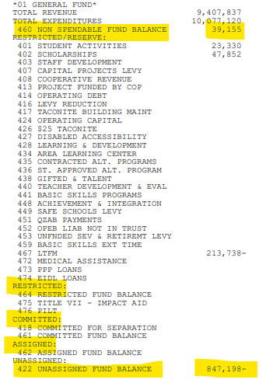
SOD Calculation
Fund Balance: $ (808,043)
Expenditures: $9,154,508
SOD calculation: -8.83%
In this example, the fund balance equals 460 Non-Spendable and 422 Unassigned ($847,198 less 39,155) = $(808,043)
Note: Fund balance includes the Non-Spendable, Restricted, Committed and Assigned and Unassigned Fund Balances.

Slide 73
SOD Special Operating Plan
By January 31 of the following fiscal year of SOD, the school and the school board of education are required to create and implement a Special Operating Plan which is formally approved through a board resolution and submitted to the commissioner of the Minnesota Department of Education for approval.
The Special Operating Plan consists of the following sections:
  Introduction and Explanation of Current SOD Position (Narrative)
  Budget Development and Financial Management Process (Narrative)
  Ongoing Financial Monitoring Processes and Procedures (Narrative)
  Action Plan to remove SOD Status (Narrative)
  Special Financial Operating Plan (Excel Spreadsheet Model)
  Board Resolution
Notes:
This is very time consuming work for the entity in SOD.

Slide 74

UFARS Coding Guidance
UFARS COVID-19 Coding Guidance

Slide 75
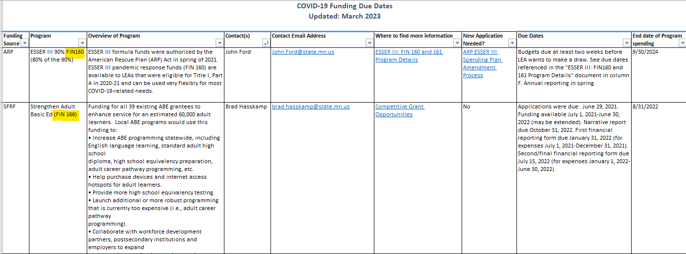
Federal Funds Due Dates and Contacts
MDE webpage>COVID-19>Federal Relief Funds
Go about ½ way down page to Funding Relief Funding Resources and click on the document: COVID-19 Funding Due Dates published 3/2023
Notes:
This document lists the federal funding source, the title of funds with UFARS Finance Code, contact(s), contact email address, where to find more information, new application needed info, due dates and the end date for spending.

Slide 76
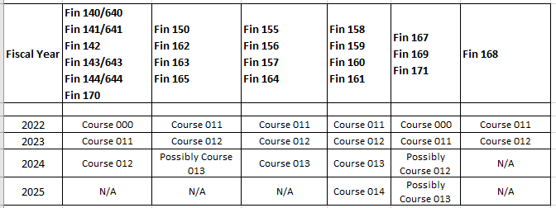
Federal Funds UFARS Course Codes

Slide 77
COVID-19 UFARS Coding
For Finance Codes 140/640, 141/641, 143/643 and 144/644, please follow UFARS Finance Code 699 Miscellaneous Federal funds Received From Other Districts/Agencies instructions in Chapter 4 (paraphrased below).
Record the revenues and expenditures for federal aid received as a sub-award from an entity other than MDE or U.S. Dept of Education. The use of any 600 series finance code is for tracking a federal sub-award grant from another district or agency (i.e., cooperative or education district) where the receiving district has continual responsibility for the federal revenue. Corresponding numbers must be used.

Slide 78
COVID-19 UFARS Coding
Due to the pandemic, there are additional funds flowing to LEAs from Department of Human Services (DHS).
Unemployment reimbursement from DHS, should be coded to the original expenditure in Object Code 280.
Additional Medical Assistance Revenue from DHS should be coded to Finance Code 372 with Source Code 071 – Medical Assistance Revenue Received from Minnesota Department of Human Services.
Please use Finance Code 699 Miscellaneous Federal funds Received From Other Districts/Agencies for additional funding streams from state/federal

Slide 79
Federal Connectivity Funds
For the Federal Connectivity Funds, there is not a specific finance code for this funding. The finance code that fits best is below.
Finance Code 699: Miscellaneous Federal Revenue Received from Other Districts/Agencies
Record the revenues and expenditures for miscellaneous federal aid received as a sub-award from an entity other than the Minnesota Department of Education or the U.S. Department of Education where there is no other designated finance code. The use of any 600 series finance code is for tracking a federal sub-award grant from another district or agency where the receiving district has continual responsibility for the federal revenue. Corresponding numbers must be used between the 400 and 600 series codes.
Example:
419 – Federal Special Education = 619 – Federal Special Education Subaward; or
428 – Carl Perkins = 628 – Carl Perkins Subaward
This accounting procedure will eliminate double accounting of federal revenue and expenditures.

Slide 80

GASB Statement No. 87 Leases Effective FY 2022 and
GASB Statement No. 96 SBITAs Effective FY 2023
(for reference)

Slide 81
GASB 87 - Certificates of Participation
Finance Code 791 Projects Funded by Certificates of Participation/Financed Purchase (COP/FP) Agreement with Related Lease Levy Authority is used for the issuance of certificates of participation (COP). COP issuance is a mechanism for providing capital to school districts to purchase equipment, finance constructions projects, or refinance existing leases. This financing technique provides long-term financing through a lease with an option to purchase or a conditional sales agreement.
Note: For Fund 01 General Fund financial transactions, the activity must close to the 01-422-XX Unassigned Fund Balance. Fund 06 Building Construction Fund financial transactions, the activity must close to 06-413-XX Restricted/Reserved for Projects Funded by Certificates of Participation/Financed Purchase (COP/FP) Agreement with Related Lease Levy Authority

Slide 82
GASB 87 Certificates of Participation
The accounting for Finance Code 791 Projects Funded by Certificates of Participation/Financed Purchase (COP/FP) Agreement with Related Lease Levy Authority has been updated for FY 23.
We collaborated with the GASB Subcommittee and the Advisory Committee for Financial Management on updating the accounting treatment effective for FY 23.
We want to thank the participants on these two committees for their valuable time!
Please see SBB # 70 and/or FY 23 UFARS Chapter 13 the GASB 87 section for the appropriate accounting for COP/FP.

Slide 83
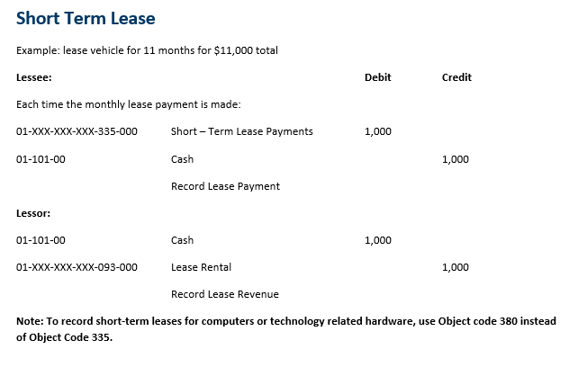
GASB 87 Short Term Lease
See School Business Bulletin #68 and UFARS Chapter 13 for additional GASB 87 information and accounting treatment.

Slide 84
FY 23 UFARS Finance Code 348 and Lease Levy
348 Charter School Building Lease Aid and School District Lease Levy Authority (Fund 01)
Charter Schools should record revenue and expenditures for Charter School Building Lease Aid. When a charter school finds it economically advantageous to rent or lease a building or land for any instructional purpose and it determines that the total operating capital revenue per Minnesota Statutes 2021, section 126C.10, subdivision 13, is insufficient for this purpose, it may apply to the commissioner for Building Lease Aid per Minnesota Statutes 2021, section 124E.22.
School district types 01, 02 or 03 can record revenue and expenditures for lease levy authority in this code for expenditures to lease a building or parcel of land for instructional purposes only. Instructional purposes means that it relates to the current academic curriculum. Curriculum may include but is not limited to sports fields/venues utilized during physical education, additional classroom space for increased student population, facilities that meet academic curriculum requirements not found in their current facilities (i.e. computer or science and technology labs). School district building lease aid should not be used for facilities or land that is outside of the current academic curriculum. Facilities that fall under this classification are lighted sports fields or facilities used solely outside of normal operating hours, graduation venues, student and/or employee parking, etc. should be coded to any other appropriate finance codes.
This finance code must be used only with Program Code 850.
Payment Description – 01F348 BLDGLEASE AID FY
Notes:
FY 23 Changes

Slide 85
GASB 96
GASB 96 - Subscription-Based Information Technology Arrangements (SBITAs)
Definition of a SBITA:
A SBITA is a contract that conveys control of the right to use another party’s (a SBITA vendor’s) information technology (IT) software, alone or in combination with tangible capital assets (the underlying IT assets), as specified in the contract for a period of time in an exchange or exchange-like transaction.
Definition of the subscription term:
The subscription term includes the period during which a government has a noncancelable right to use the underlying IT assets. The subscription term also includes periods covered by an option to extend (if it is reasonably certain that the government or SBITA vendor will exercise that option) or to terminate (if it is reasonably certain that the government or SBITA vendor will NOT exercise that option).

Slide 86
GASB 96
GASB 96 Subscription-Based Technology Agreements (SBITAs) are for the right to use intangible assets – such as software and must be implemented for FY 2023.
GASB 96 is similar to GASB 87. Short-term SBITAs with a term of less than 12 months will have different expenditure codes than SBITAs that have a term of more than 12 months. There also will be implied interest with SBITAs that have a term of more than 12 months. Schools must determine the interest expenditures if it is not explicitly stated.
It will be helpful to begin making a list of all the software agreements and subscriptions with the length of term for each agreement for your entity.
Subscribe to the School Business Bulletin to receive the UFARS updates for this new GASB statement. This information is included in SBB #71.

Slide 87
GASB 87 and 96 Object Codes
Object Codes |  |  |  |  |  | Object Codes 3xx = Purchased Services
Progression from FY 21 to FY 22 (for GASB 87) and FY 23 (for GASB 96) |  |  | Blue is new, Green was updated in FY 22 and needs update for FY 23 |  |  | Object Codes 4xx = Supplies
 |  |  |  |  |  | Object Codes 5xx = Capital
Code | Object Code Title – Prior to FY 22 | Code | GASB 87 Object Codes – FY 22 | Code | GASB 96 Object Codes – FY 23 | Notes
315 | Repairs and Maintenance for Computer and Technology | 315 | Updated for GASB 87 in FY 22 | 315 | Repairs, Maintenance and Service Agreements for Computers, Tech and Software | Update description for GASB 96
 |  | 335 | Short-Term Lease Payments or Short-Term Rentals (used for bldgs/ice rental, etc.) | 335 | No change to title | Update description for GASB 96
370 | Operating Leases or Rentals - Deleted for FY2022 - replaced by Object Codes: 570/571 |  | Object 370 was deleted in FY 22
380 | Computer and Technology Related Hardware Rental | 380 | Short-Term Leases for Computer or Technology Related Hardware Rental | 380 | Short-Term Leases for Computer or Technology Related Hardware Rental | This Code will be phased out for FY 24 – Use Objects 465/466
405 | Non-Instructional Software Licensing Agreements |  |  | 405 | Non-Instructional Software Licensing Agreement Purchases or Short-Term Non-Instructional Subscription-Based Information Technology Arrangements (SBITAs) | Update description for GASB 96
406 | Instructional Software License Agreements |  |  | 406 | Instructional Software Licensing Agreement Purchases or Short-Term Instructional Subscription-Based Information Technology Arrangements (SBITAs) | Update description for GASB 96

Slide 88
GASB 87 and 96 Object Codes
Object Codes |  |  |  |  |  | Object Codes 3xx = Purchased Services
Progression from FY 21 to FY 22 (for GASB 87) and FY 23 (for GASB 96) |  |  | Blue is new, Green was updated in FY 22 and needs update for FY 23 |  |  | Object Codes 4xx = Supplies
 |  |  |  |  |  | Object Codes 5xx = Capital
Code | Object Code Title – Prior to FY 22 | Code | GASB 87 Object Codes – FY 22 | Code | GASB 96 Object Codes – FY 23 | Notes
455 | Non-Instructional Technology Supplies |  |  | 455 | Non-Instructional Technology Supplies | Update description for GASB 96
456 | Instructional Technology Supplies |  |  | 456 | Instructional Technology Supplies | Update description for GASB 96
460 | Textbooks and Workbooks |  |  |  |  | No Changes at this time.
465 | Non- Instructional Technology Devices |  |  | 465 | Non- Instructional Technology Devices | Update description for GASB 96
466 | Instructional Technology Devices |  |  | 466 | Instructional Technology Devices | Update description for GASB 96
505 | Capitalized Non-Instructional Technology Software |  |  | 562 | Principal on Long-Term Non-Instructional Subscription-Based Information Technology Arrangements (SBITAs) | Obj 505 is for purchases that meet capitalization threshold - update object code references
506 | Capitalized Instructional Technology Software |  |  | 563 | Interest on Long-Term Subscription-Based Information Technology Arrangements (SBITAs) | Obj 506 is for purchases that meet capitalization threshold, update object code references
 |  |  |  | 564 | Principal on Long-Term Instructional Subscription-Based Information Technology Arrangements (SBITAs)
535 | 535 Long-Term Leases or Financed Purchases |  |  | 535 | 535 Long-Term Leases or Financed Purchases | Add software in the description

Slide 89
GASB 87 and 96 Object Codes
Object Codes |  |  |  |  |  | Object Codes 3xx = Purchased Services
Progression from FY 21 to FY 22 (for GASB 87) and FY 23 (for GASB 96) |  |  | Blue is new, Green was updated in FY 22 and needs update for FY 23 |  |  | Object Codes 4xx = Supplies
 |  |  |  |  |  | Object Codes 5xx = Capital
Code | Object Code Title – Prior to FY 22 | Code | GASB 87 Object Codes – FY 22 | Code | GASB 96 Object Codes – FY 23 | Notes
555 | Capitalized Non-Instructional Technology Hardware | 560 | Principal on Long-Term Computer or Technology Related Hardware Leases or Financed Purchases |  |  | Obj 555-is for purchases that meet capitalization threshold
556 | Capitalized Instructional Technology Hardware | 561 | Interest on Long-Term Computer or Technology Related Hardware Leases or Financed Purchases |  |  | Obj 556-is for purchases that meet capitalization threshold
 |  | 570 | Principal on Long-Term Building or Land Leases
 |  | 571 | Interest on Long-Term Building or Land Leases
580 | Principal on Capital Lease/Installment Sales Contracts | 580 | Principal on Long-Term Lease or Financed Purchases
581 | Interest on Capital Lease/Installment Sales Contracts | 581 | Interest on Long-Term Lease or Financed Purchases
582 | Principal on Capital Lease/Installment Sales Contracts Used for Direct Instruction of Special Education Students | 582 | Principal on Long-Term Lease or Financed Purchases Used for Direct Instruction of Special Education Students
583 | Principal on Capital Lease/Installment Sales Contracts Used for Vehicles Used for Special Education Students | 583 | Principal on Long-Term Lease or Financed Purchases Used for Vehicles Used for Special Education Students
589 | Lease Transactions/Installment Sales (Fund 01 – Other Financing Source) | 589 | Long-Term Lease Transactions or Financed Purchases (Fund 01-Other Financing Source) |  |  | No changes

Slide 90

UFARS Overview Summary
Questions?

Slide 91
MDE Financial Management Contacts
For UFARS Accounting, Manual and Chapter 10 Grid questions, contact the UFARS Helpdesk (MDE.ufars-accounting@state.mn.us).
Contact the MDE IT-Helpdesk for technical questions or problems with the MDE website (MDE.helpdesk@state.mn.us).

Slide 92
MDE Financial Management Contacts
Tami Hermanson Deb Meier
Charter School Lease Aid, Federal Reporting & UFARS Accounting, Manual & Training,
Financial Mgmt Training, Financial Data Requests
Education Finance Specialist Education Finance Specialist
Division of School Finance Division of School Finance
Tami.Hermanson@state.mn.us or 651-582-8771 Debra.A.Meier@state.mn.us or 651-582-8656
Pam Sanders Molly Koppes
Consolidated Financial and Profile Reports, Financial Mgmt Training, Credit
CPA Financial Audits, MDE Single Audit, Enhancement, Statutory Operating
Indirect Cost Reporting Debt (SOD)
Education Finance Specialist Education Finance Specialist
Division of School Finance Division of School Finance
Pam.Sanders@state.mn.us or 651-582-8489 Molly.Koppes@state.mn.us or 651-582-8249
Mary Weigel
Financial Management/Reporting Supervisor
Division of School Finance
Mary.Weigel@state.mn.us or 651-582-8770 mde.ufars-accounting@state.mn.us

Slide 93
MDE Special Education Contacts
Paul Ferrin Denise Berger
Special Education, Data & Analysis State Aid Calculations/MOE/SERVS
Supervisor
Angela Sepp Jill Bemis
Electronic Data & Reporting Systems (EDRS) State Aid/Vehicle Purchases/Special Pupils
Federal Allocation/Application Approval/MOE
Mary Acosta Dave Lobejko
Tuition Billing Adjustment Calculations Data Analytics Specialist
Michelle Carey
ListServ Distribution/Non-Public Fall Report
Send all email inquiries to mde.spedfunding@state.mn.us

Slide 94
Data Management Contacts
Michelle Carey Kari Johnson
MDE-ORG Ed-Fi
mde.school-verify@state.mn.us ed-fi.mde@state.mn.us
651-582-8287 651-582-8340
Sylvie Djatsa Kelly Garvey
Student ID Validation Student Transportation
mde.student_id@state.mn.us Pupiltransportation.mde@state.mn.us
651-582-8720 651-582-8524
Jeanne Krile Marilynn Loehr
PSEO, ADM WE MARSS Coordinator
Jeanne.Krile@state.mn.us marss@state.mn.us
651-582-8637 651-582-8456
Tara Chapa Gayra Ostgaard
Student Accounting Supervisor
Tara.Chapa@state.mn.us Gayra.Ostgaard@state.mn.us
651-582-8439 651-582-8339

Slide 95
Other Contacts…
SERVS Financial
How to gain access and utilize SERVS Financial – mde.servsfinancial@state.mn.us
Error messages and malfunctions when using SERVS – mde.helpdesk@state.mn.us
MARSS Student Reporting
Minnesota Automated Student Reporting System (MARSS)
contact: Marss@state.mn.us
Title Programs
Title Programs – mde.esea@state.mn.us.
Special Education
Special Education Funds – mde.spedfunding@state.mn.us.
Data Submissions (EDIAM)
MDE User Access- useraccess.mde@state.mn.us
COVID-19 Questions
COVID-19.Questions.MDE@state.mn.us
CARES Act Webpage
https://education.mn.gov/MDE/dse/health/covid19/cares/

Slide 96
Thank you!
Deb Meier and Molly Koppes
Debra.A.Meier@state.mn.us and Molly.Koppes@state.mn.us
651-582-8656 and 651-582-8249

